Slide 1
Version Control Management important component for Dev OPPs
Sarower Ahmmed

Slide 2
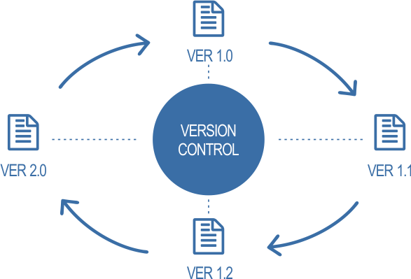

Slide 3
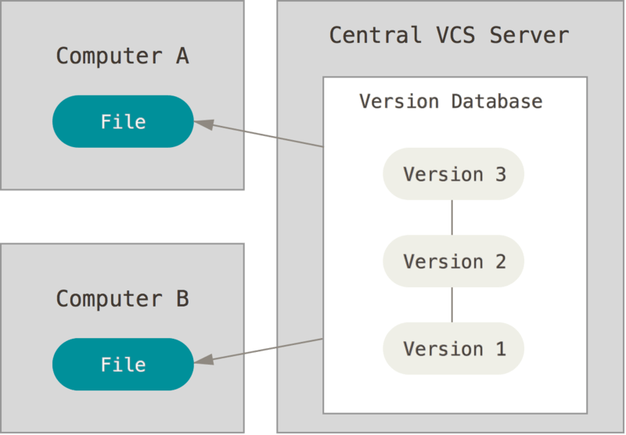

Slide 4



Home
Transport
Storage

Slide 5



Home
Transport
Storage

Slide 6
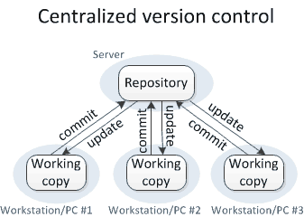

Slide 7




Popular version control in market

Slide 8
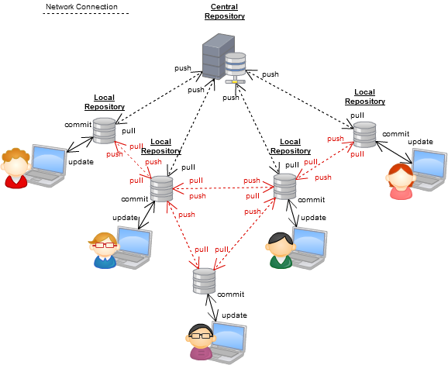

Slide 9
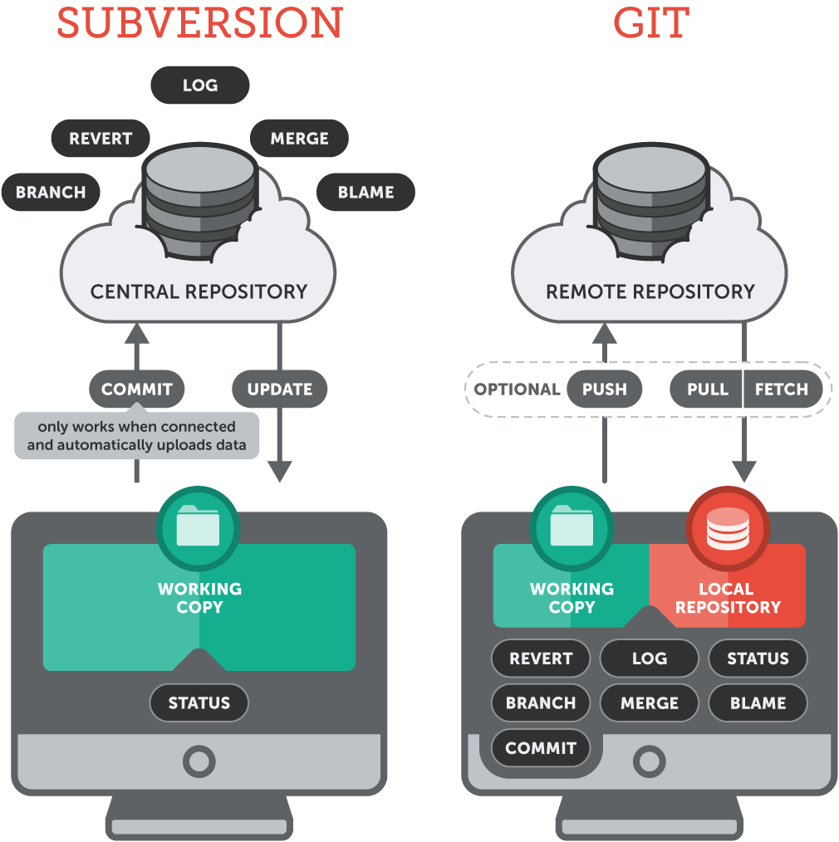

Slide 10
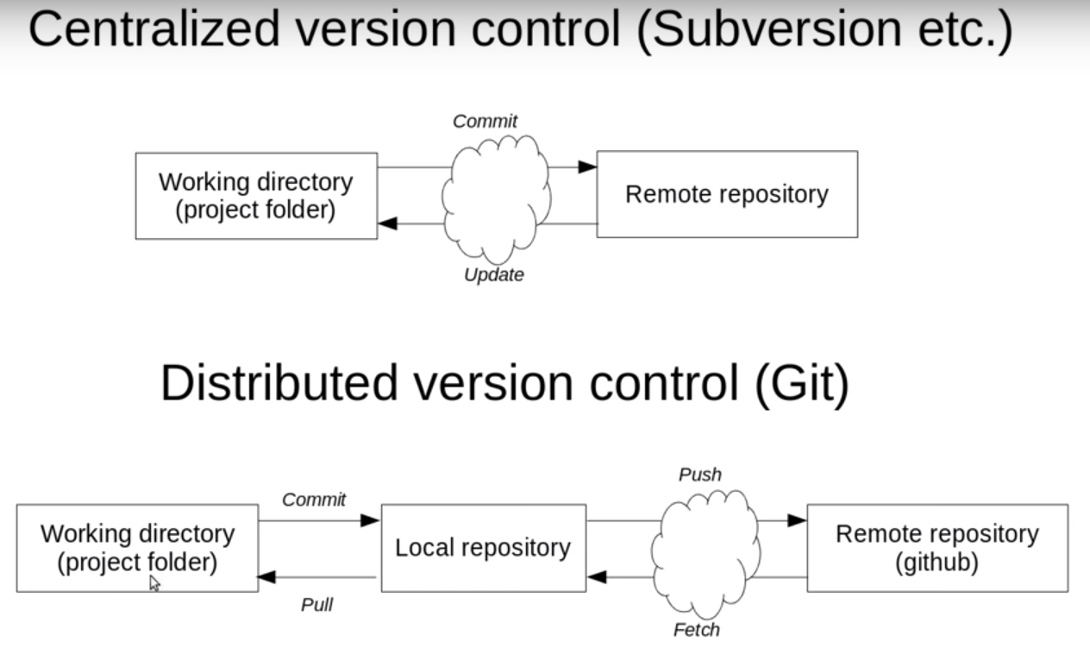

Slide 11
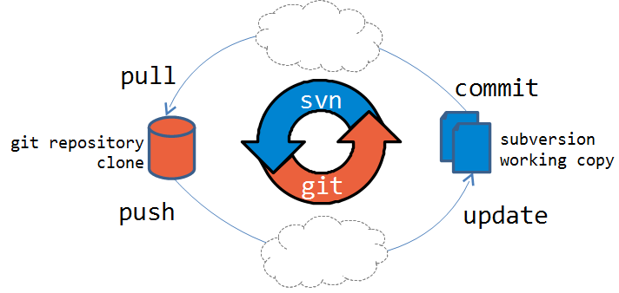

Slide 12
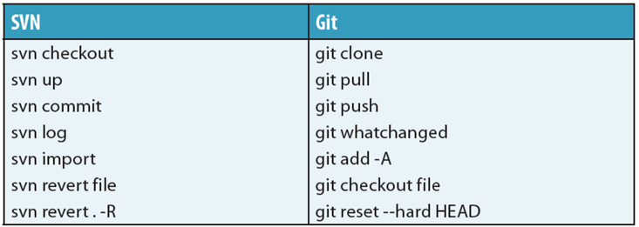

Slide 13
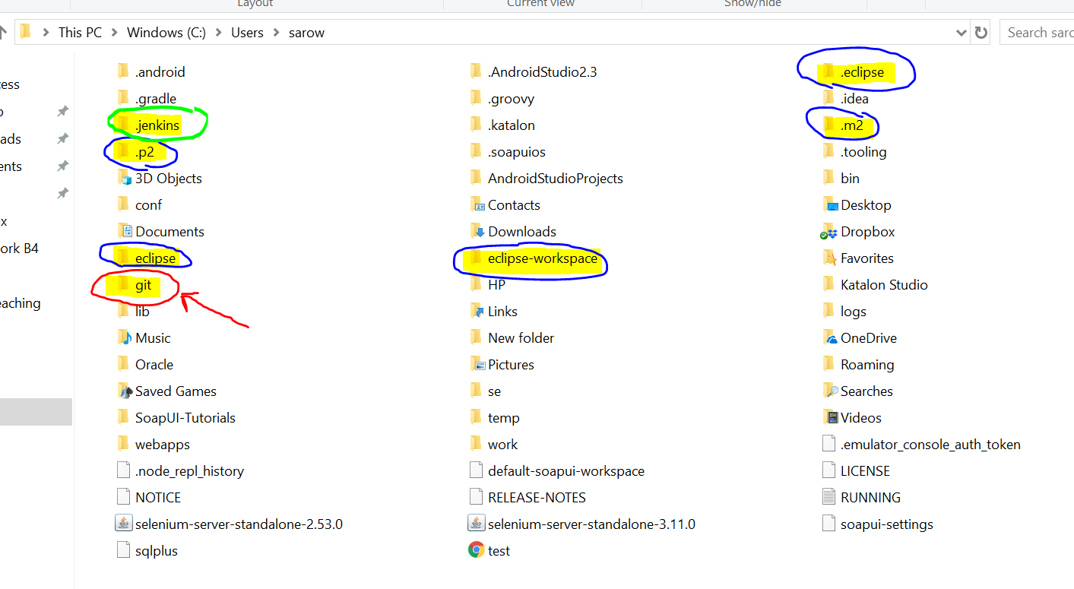
How to push project to GitHub?
1st step to create local repository
Eclipse project location – know as work space
Local repo known as git
2nd step to push local repo to central repo

Slide 14
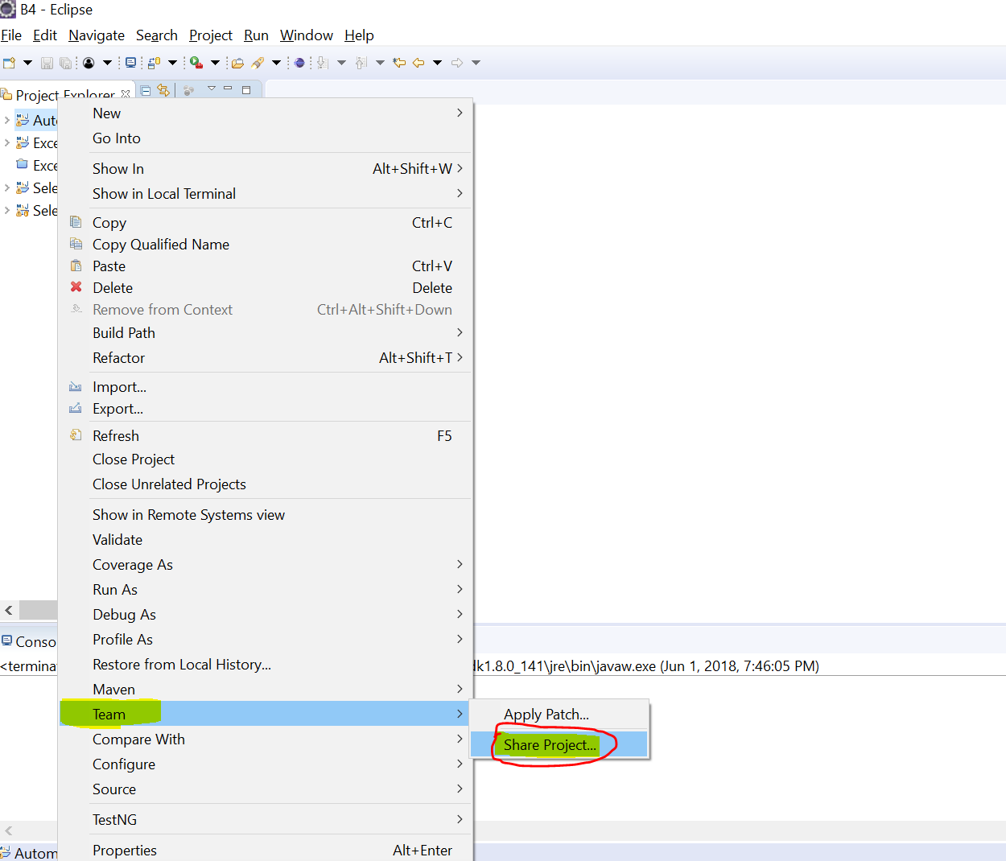

Slide 15
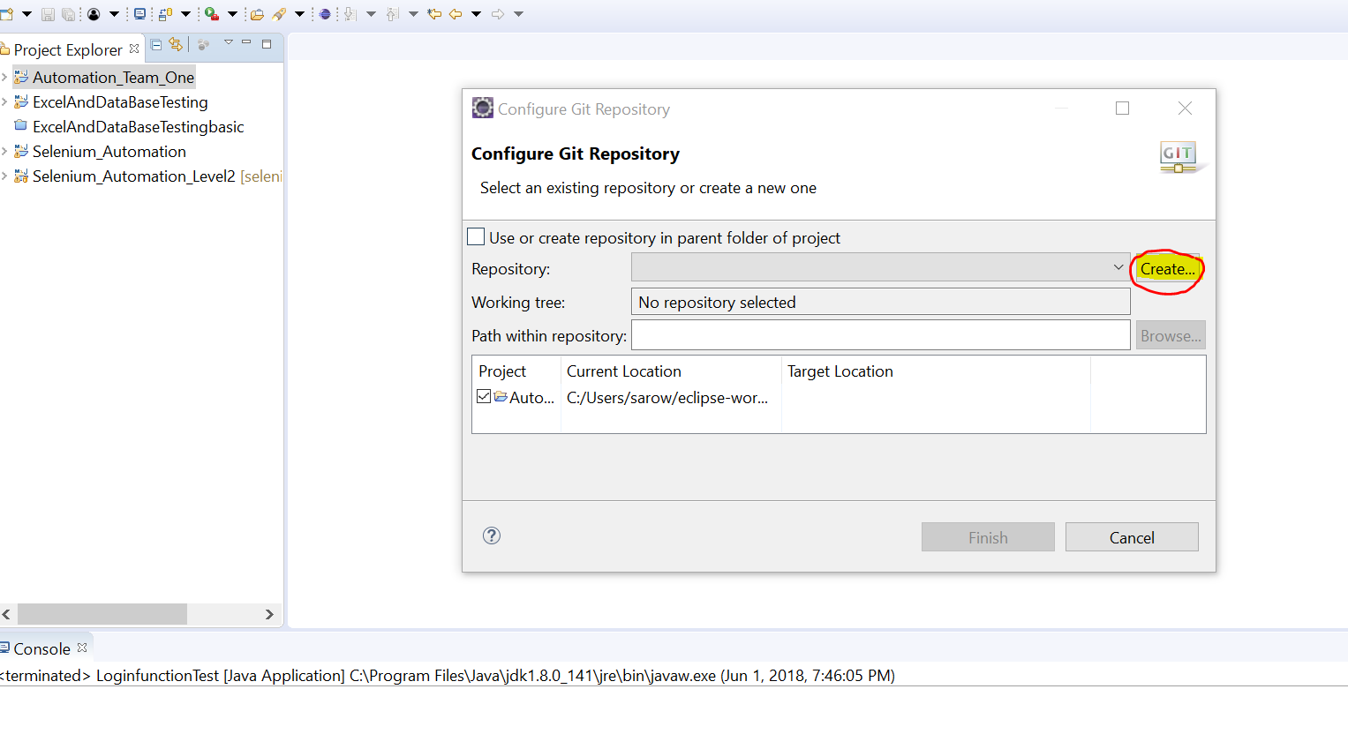

Slide 16
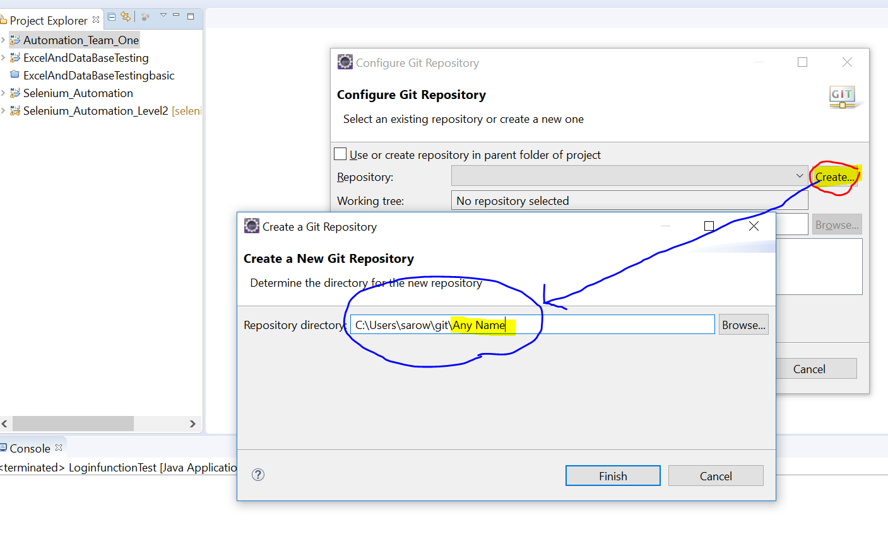

Slide 17
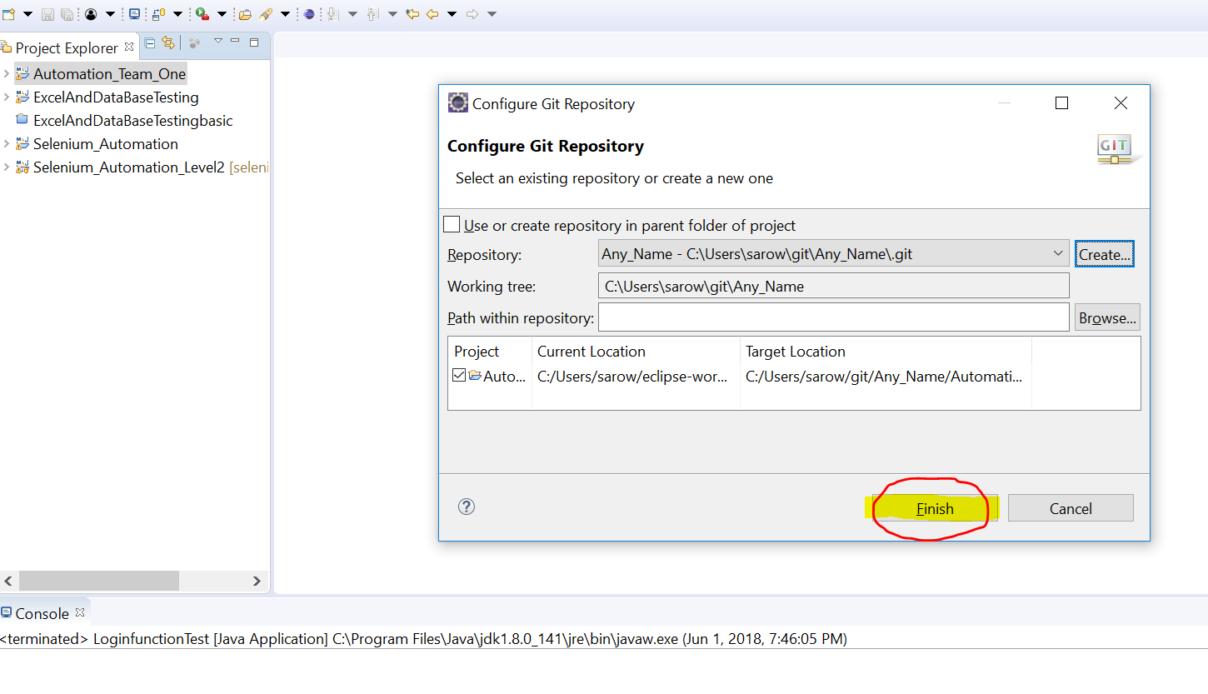

Slide 18
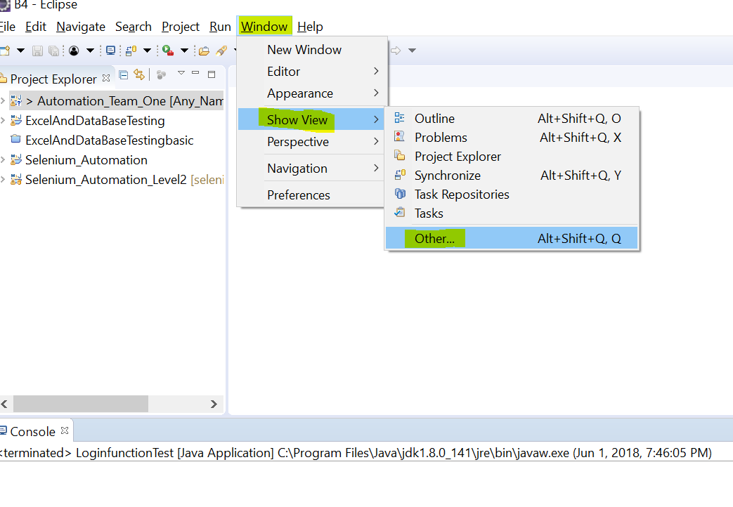
How to see local repo

Slide 19
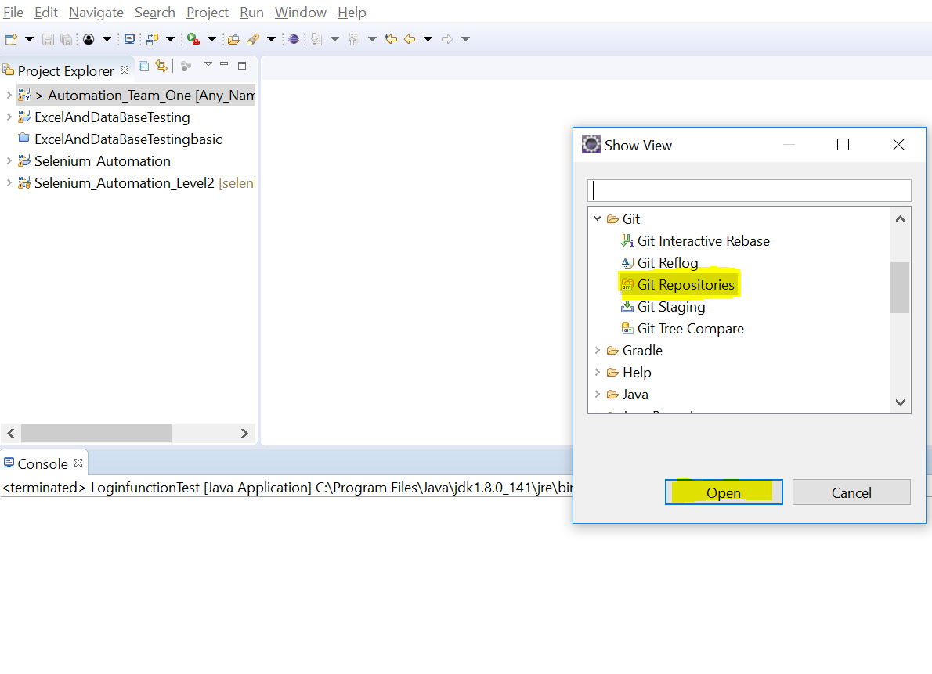
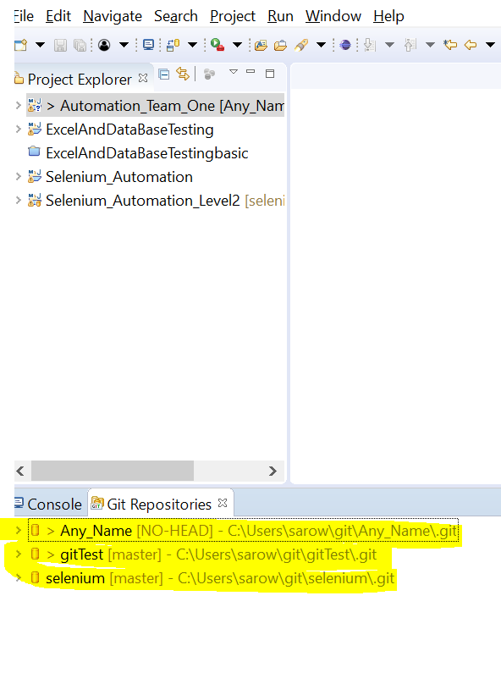

Slide 20
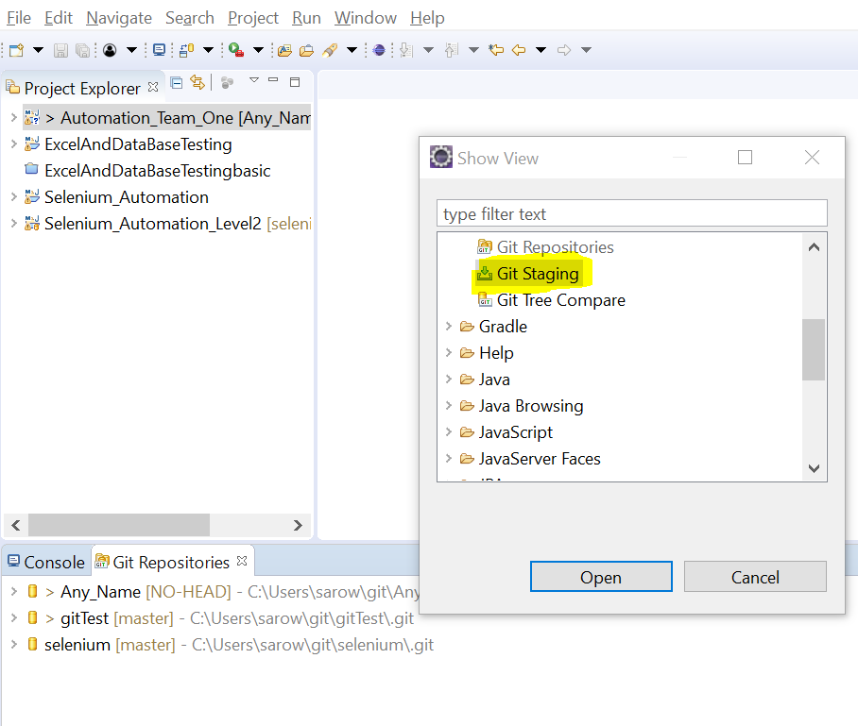
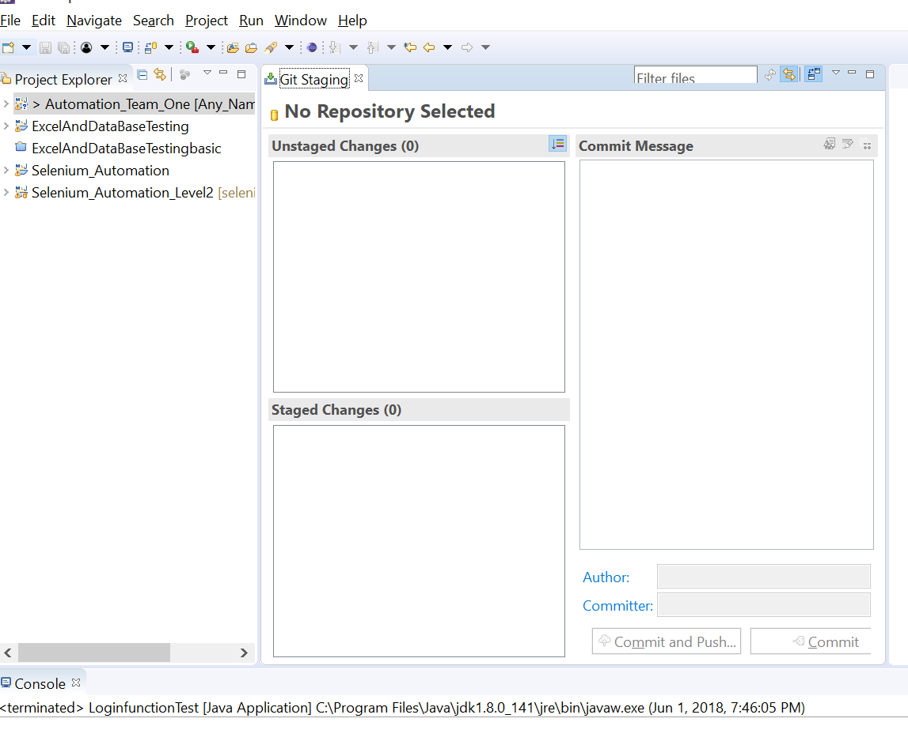

Slide 21
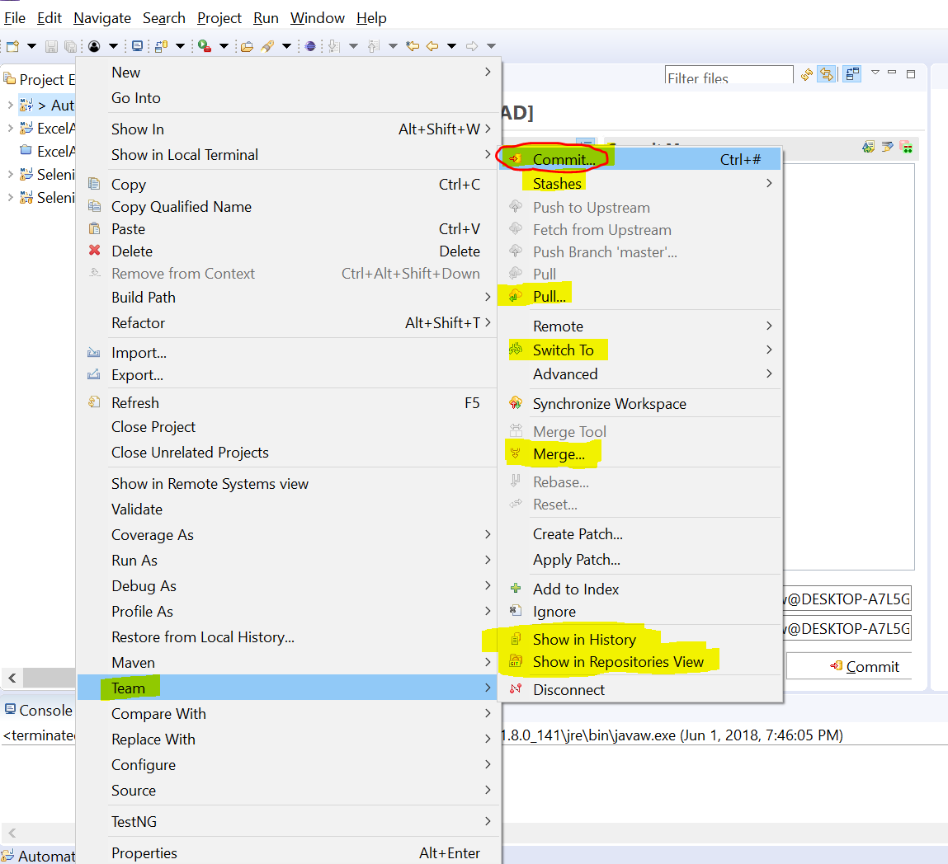
Commit = save from local to central
Stashes = if multiple people work same file>> Stashes 1st>> rebase>> to check if any conflict or not
Merge= Merge multiple repo or project into one
Show in History = can show push or pull history in details

Slide 22
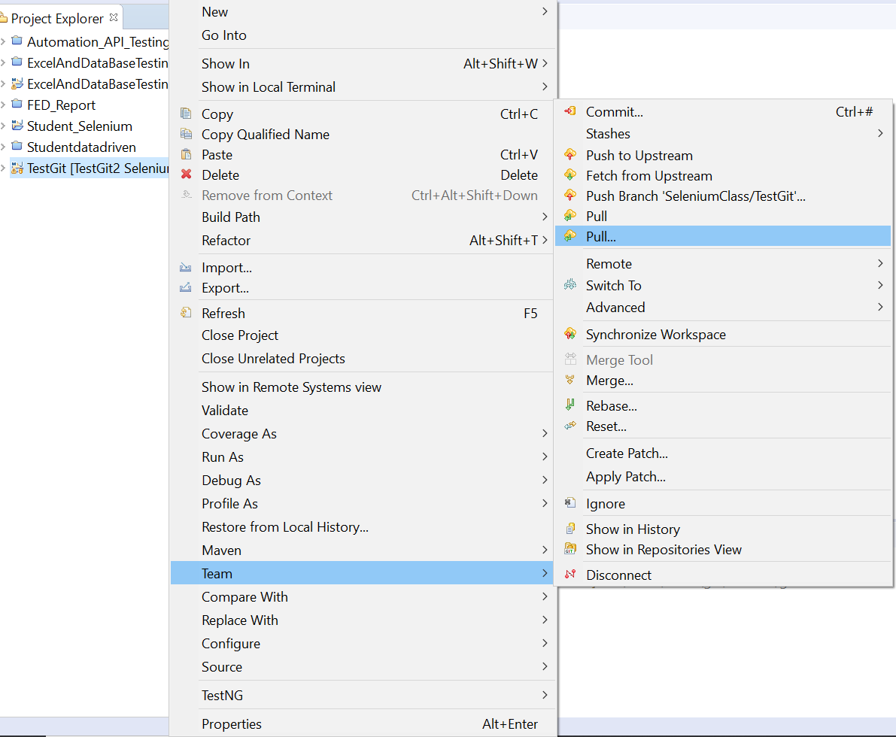
Pull= import project from GitHub repo to local, fetch+ merge➔ pull
Pull…= multiple options inside

Slide 23
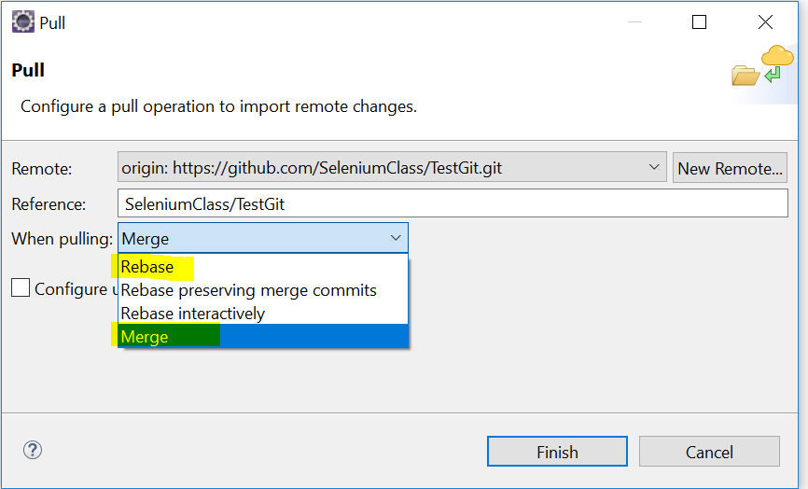
Pull… ➔ important options inside like rebase , merge

Slide 24
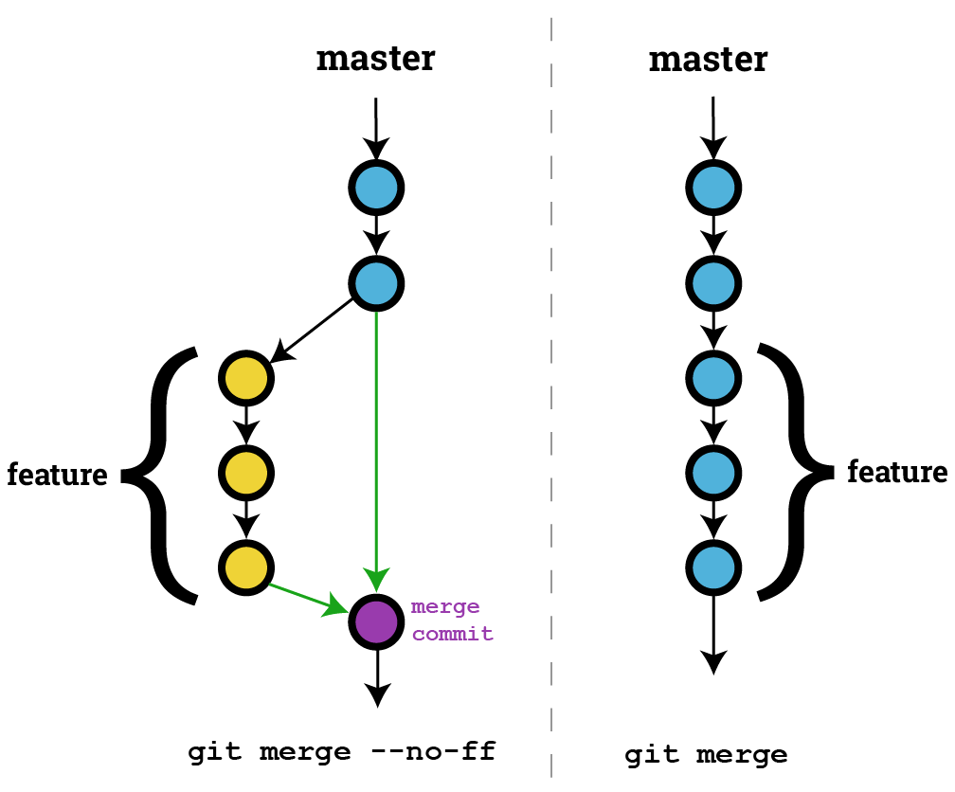
Fetching a remote
When working with other people's repositories,
there are a few basic Git commands
to remember:
• git clone
• git fetch
• git merge
• git pull
clone and fetch download remote code from a repository's remote URL to your local computer,
merge is used to merge different people's work together with yours, and
pull is a combination of fetch and merge.
Inside Pull…

Slide 25
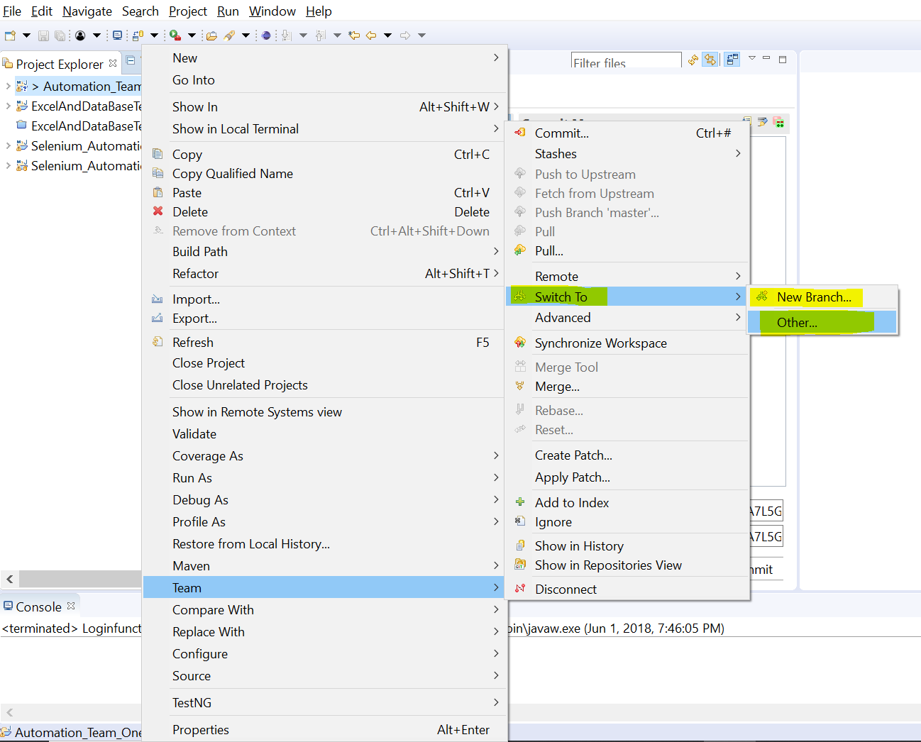
Switch To= to switch new or other old branched

Slide 26
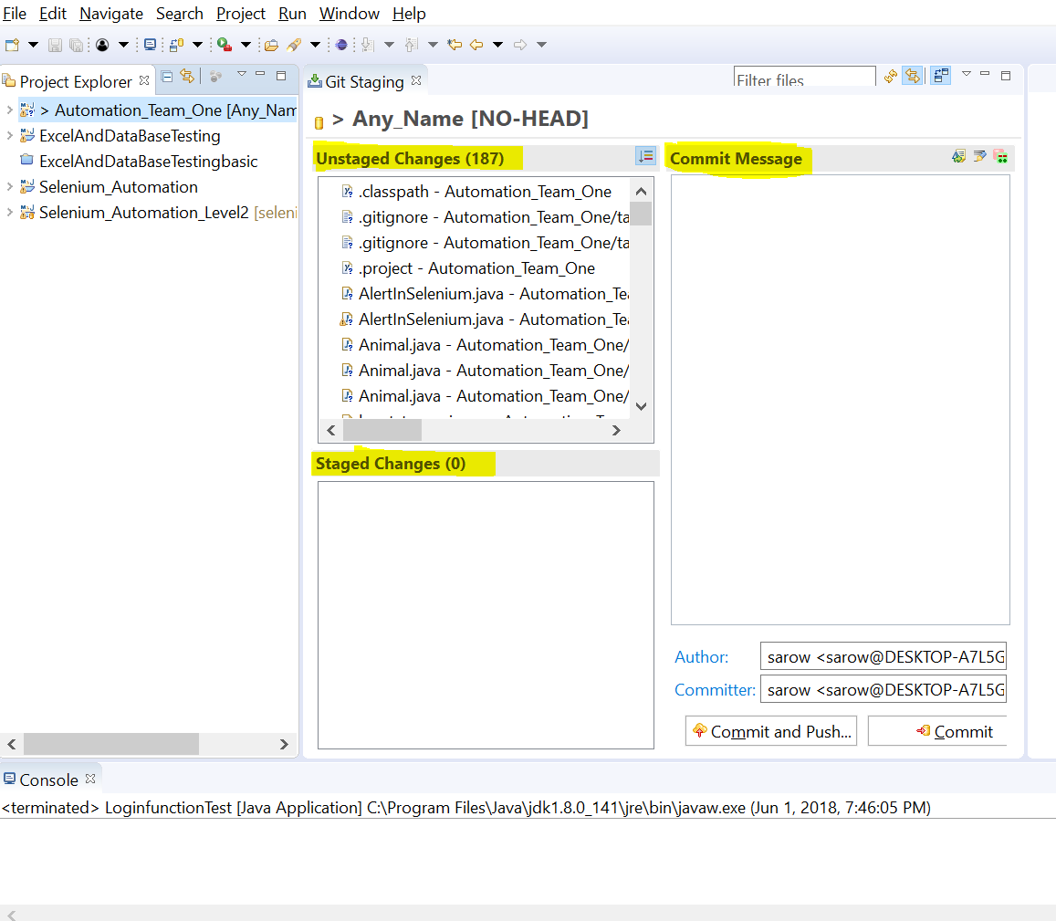
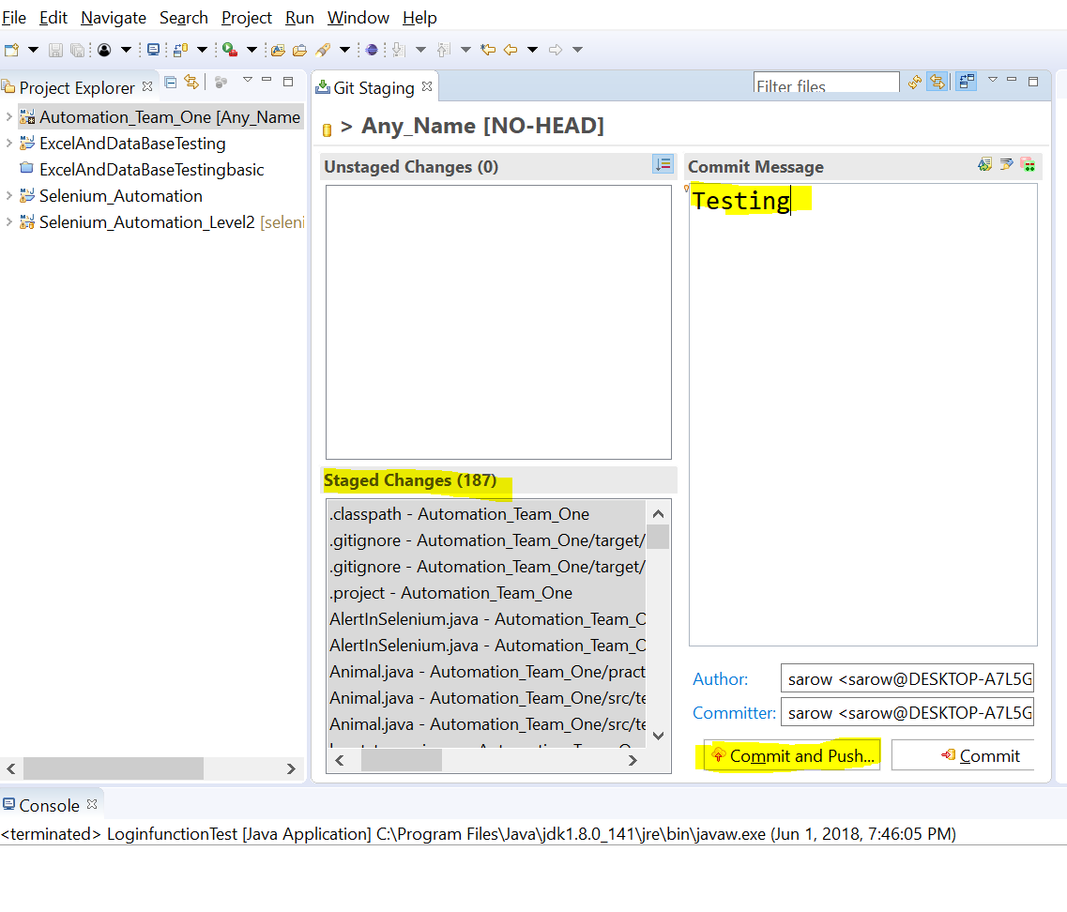

Slide 27
How to setup Git for Eclipse
Go to https://github.com/ and sign in
User Name: studentttech@gmail.com
Pass: student123
1st time create new repository
Click Clone or download> copy URL and paste it in URI

Slide 28
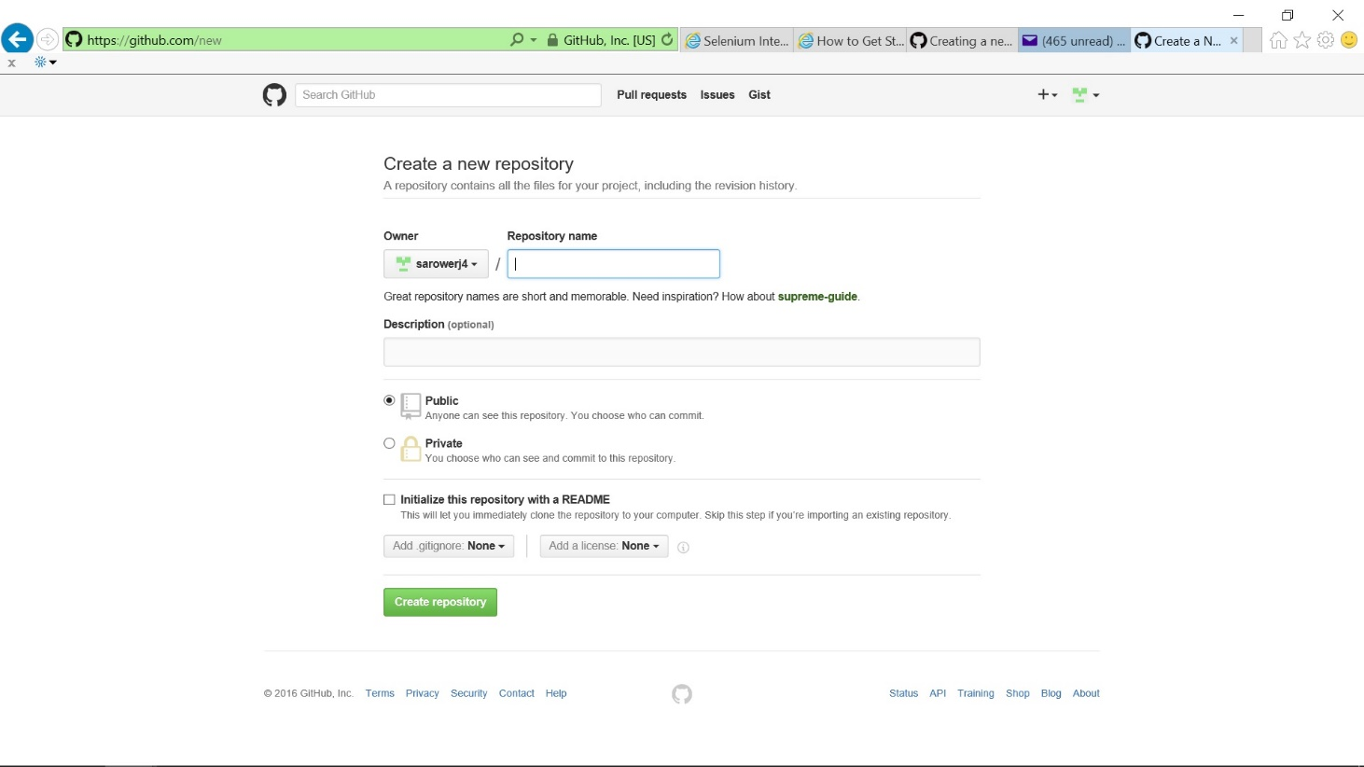

Slide 29
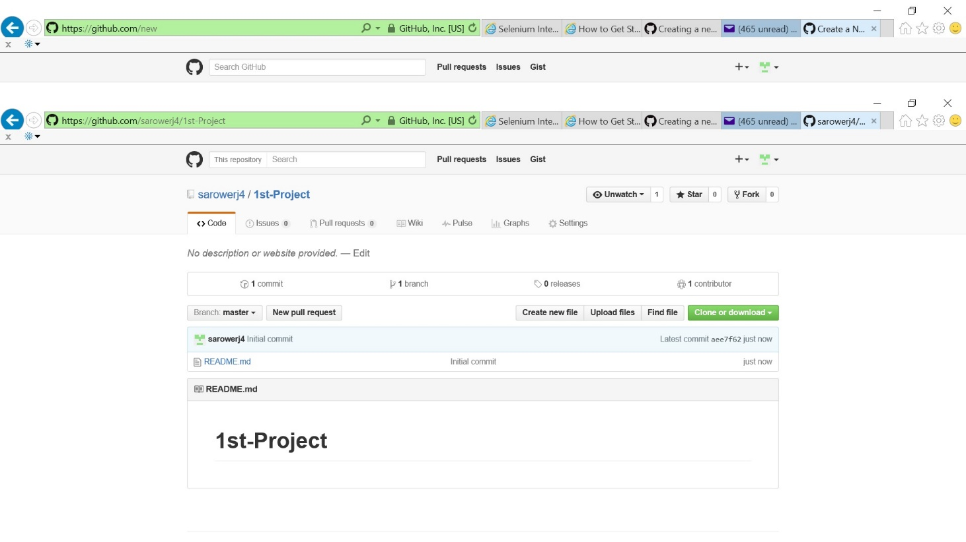

Slide 30
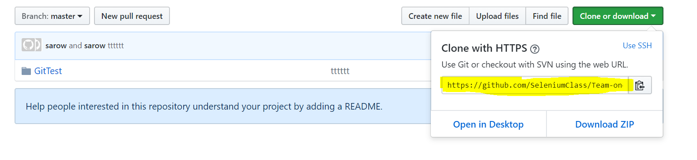
Go to 1st project: click clone and copy HTTP

Slide 31
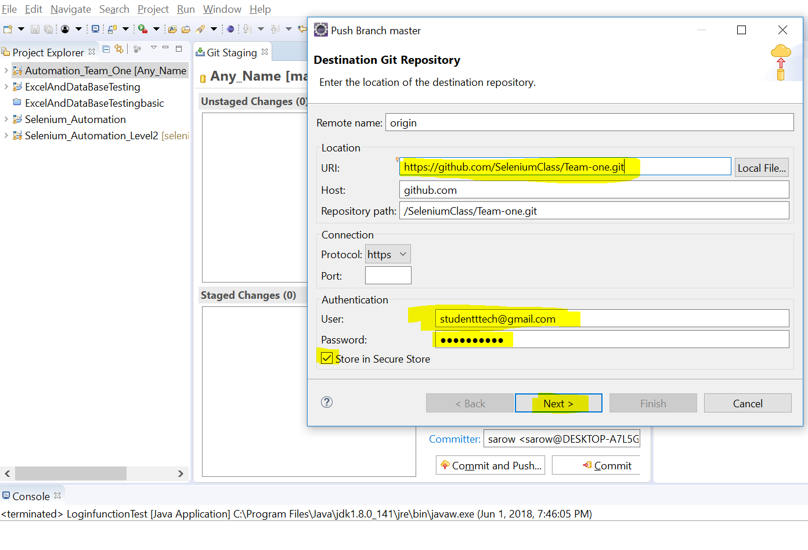

Slide 32
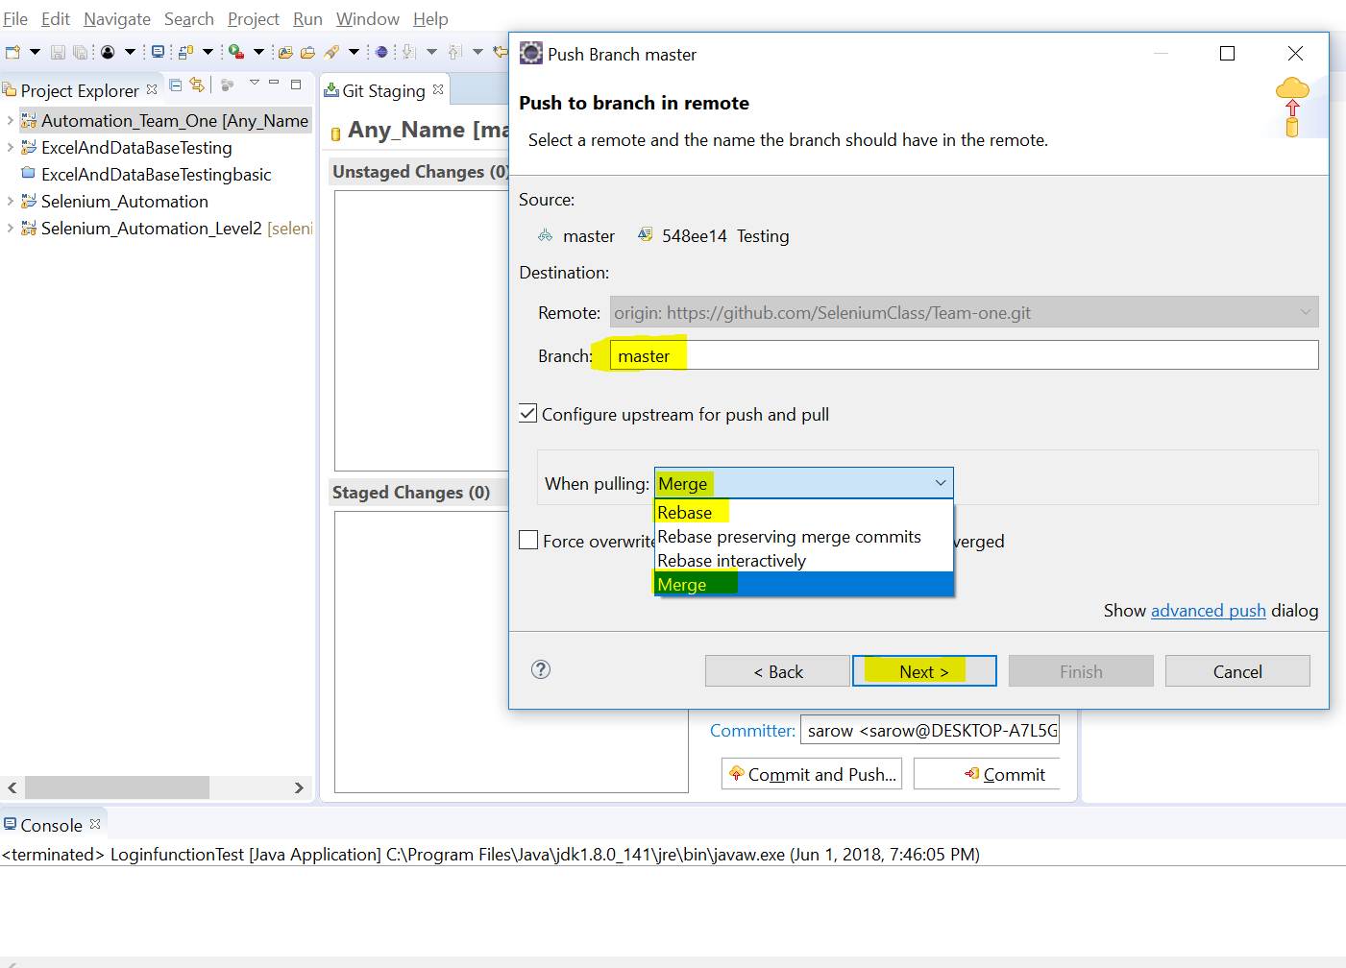

Slide 33
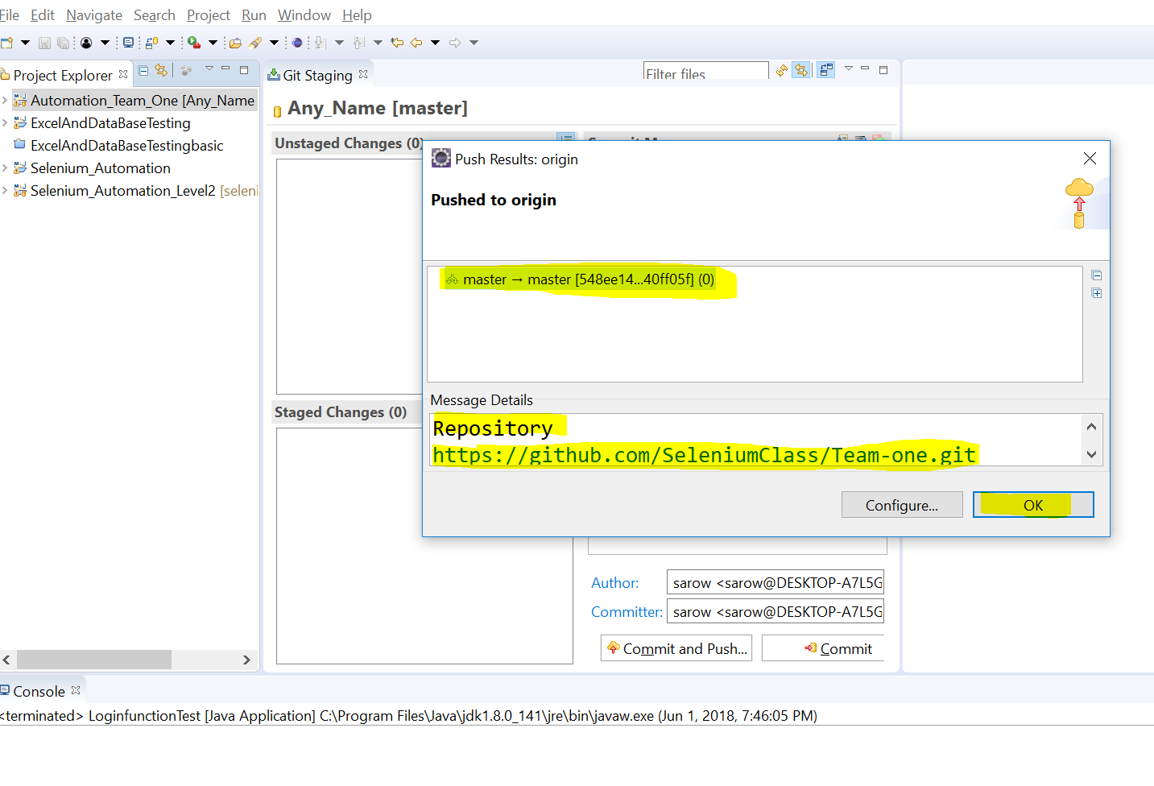
Pushed successfully

Slide 34
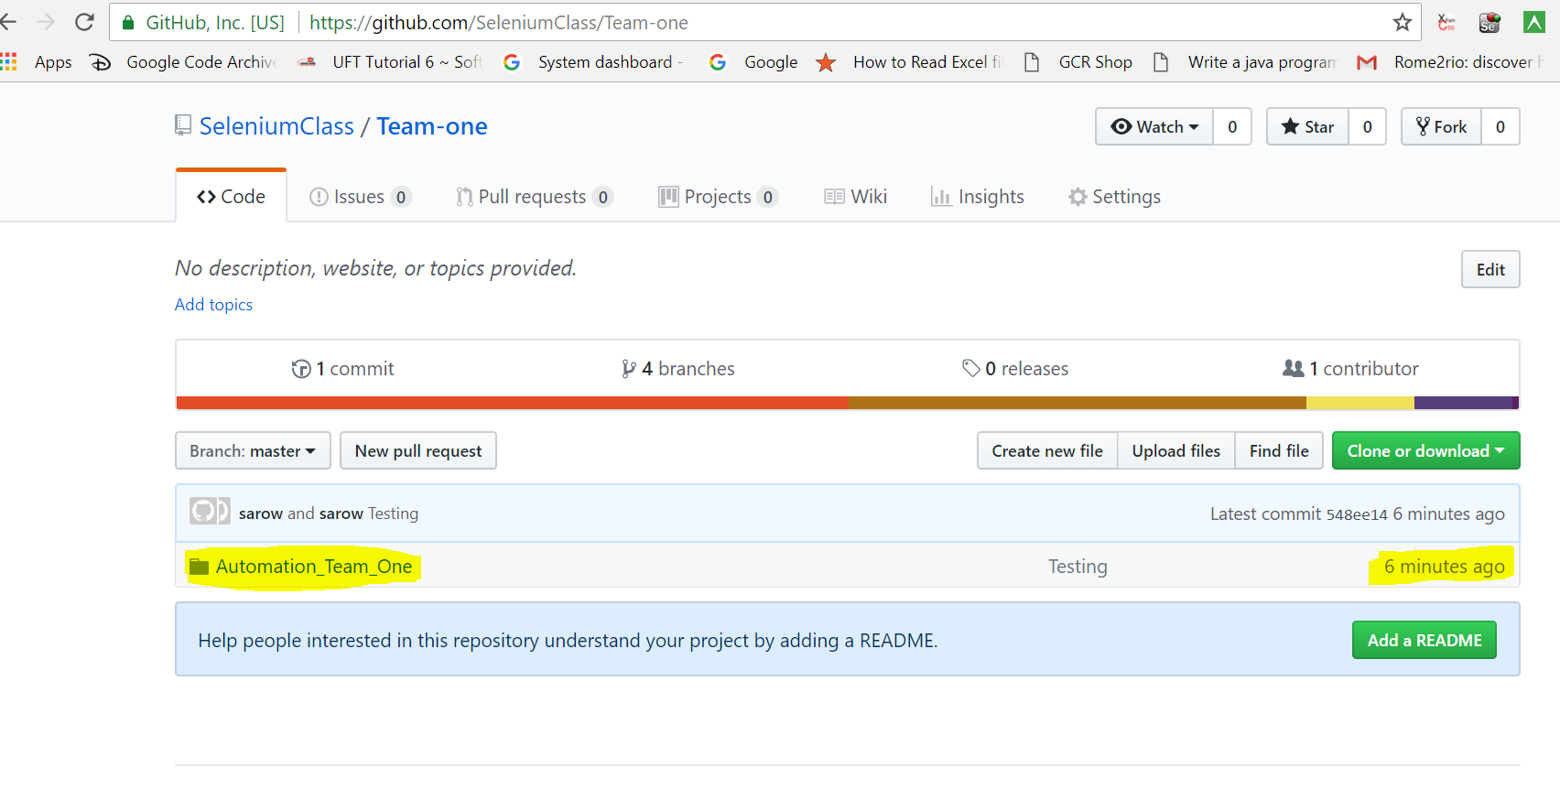
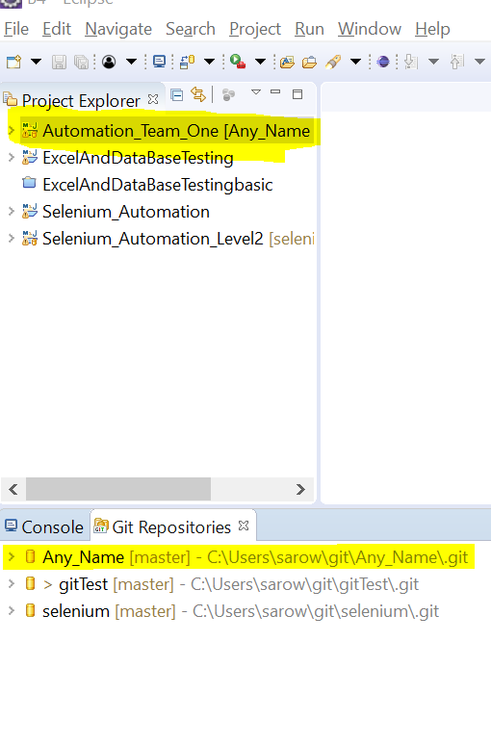
Eclipse project➔ Local➔ Central

Slide 35
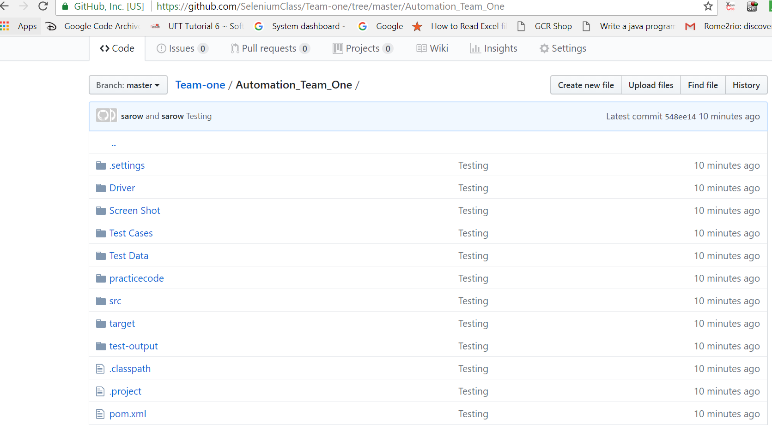

Slide 36
Import project from GitHub to Eclipse ➔ Pull

Slide 37
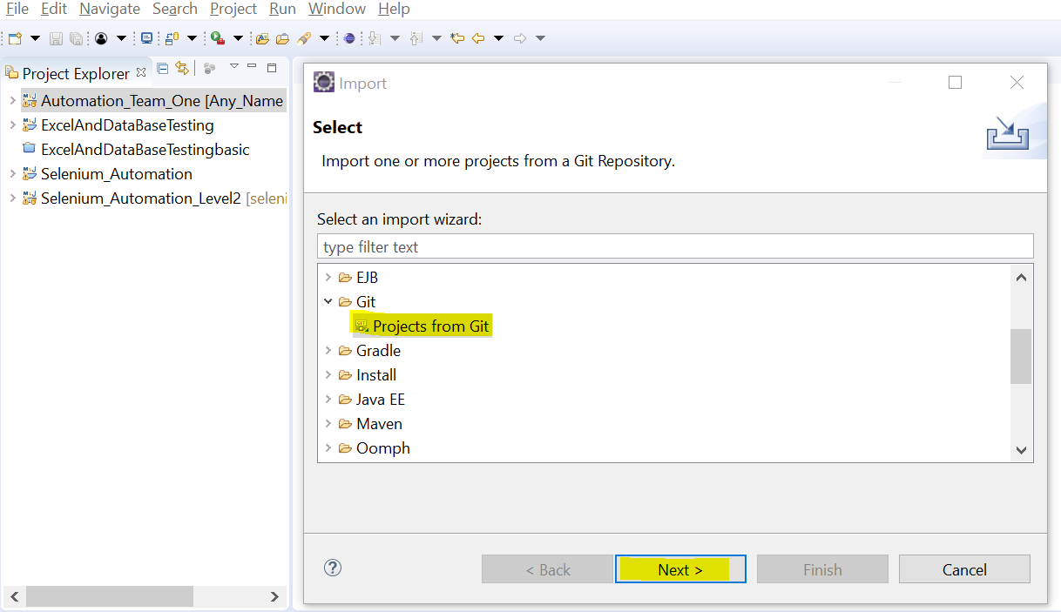
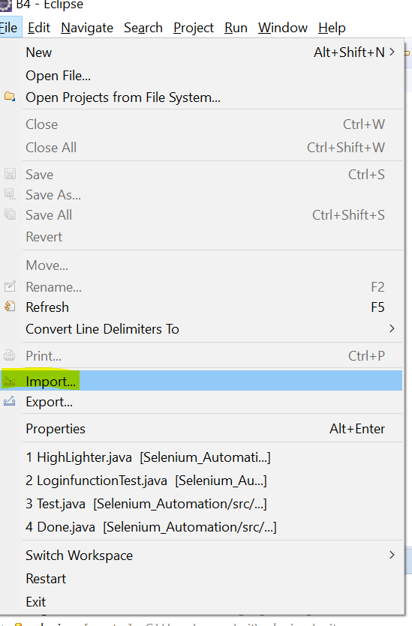

Slide 38
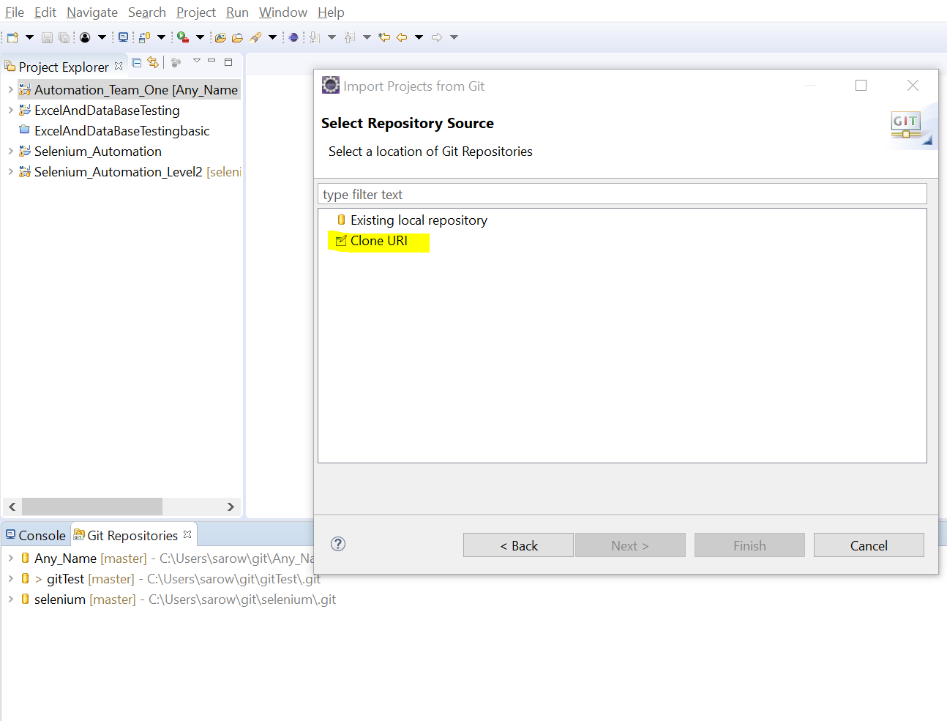

Slide 39
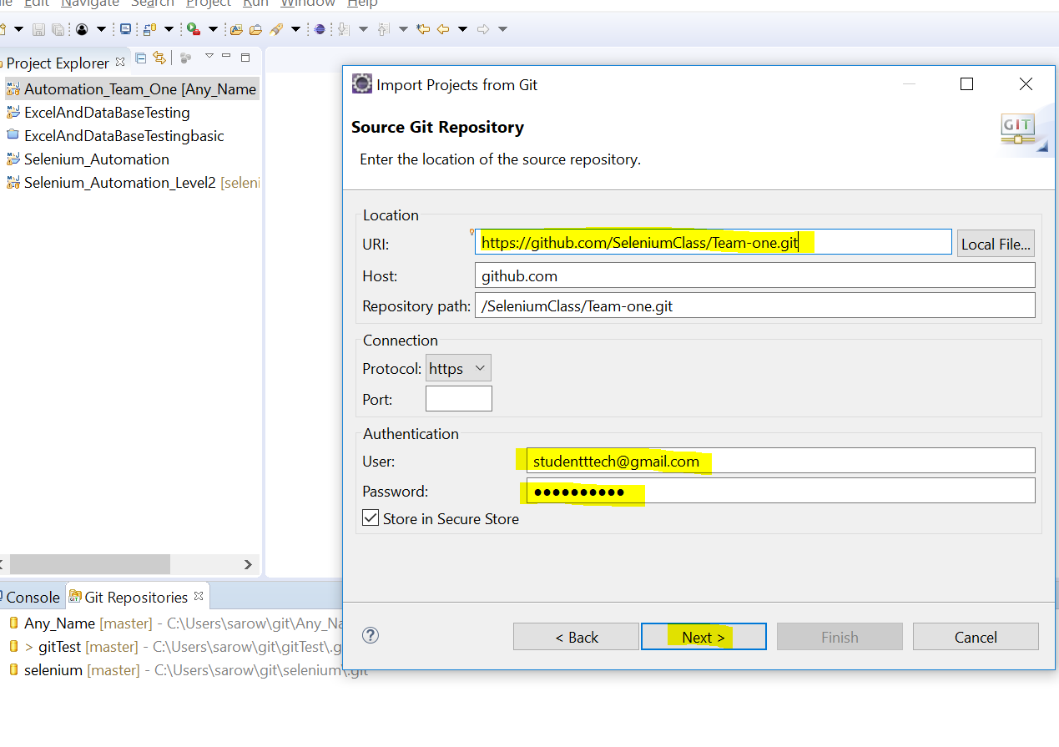

Slide 40
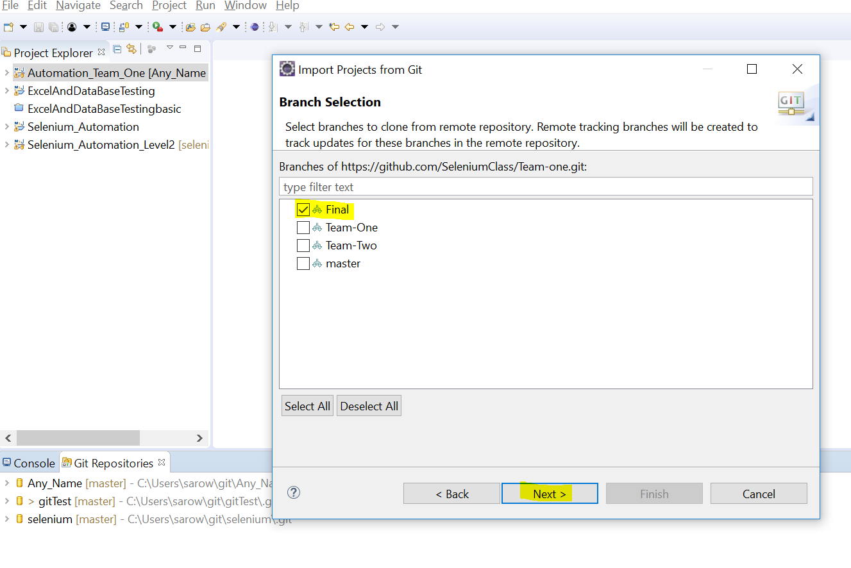

Slide 41
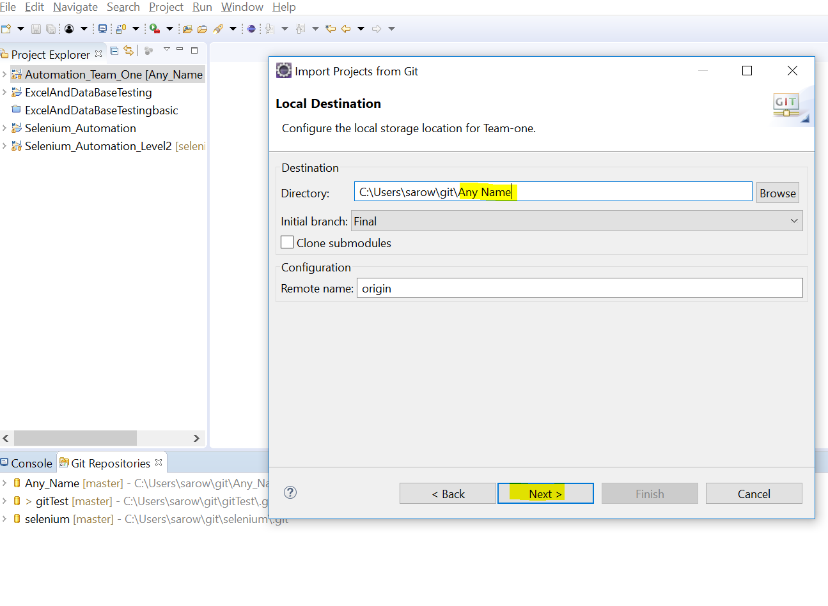

Slide 42
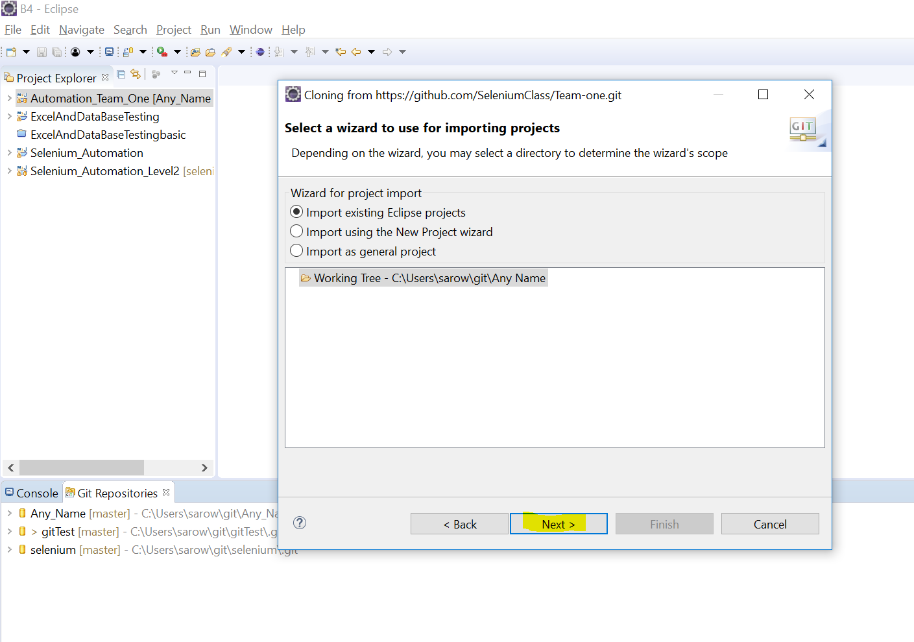

Slide 43
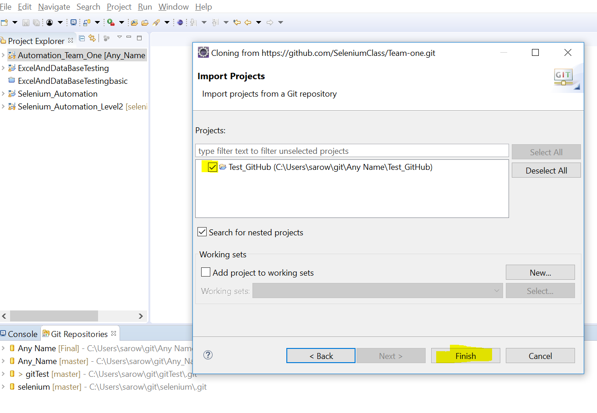
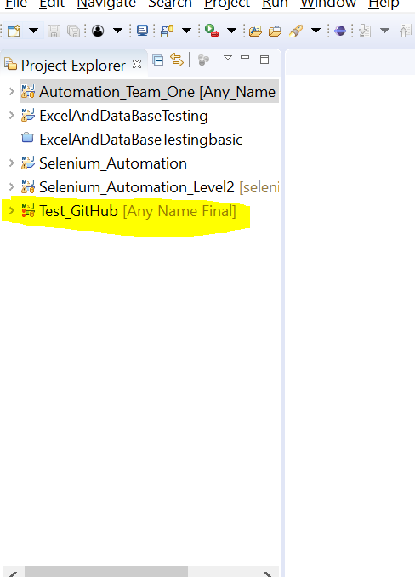

Slide 44
fast-forward error in Github
The above problem happens when the remote repository has been updated and the local one tries to push its new changes to remote without updating its content.
The problem can be resolved with a pull. You can try any one or all of the following:
1. git pull --all
2. git pull origin < your_branch_name >
3. git pull --rebase
The last option is the best one as it tries to rebase your repo against the remote preventing an extra merge commit.
More info please check - https://help.github.com/articles/dealing-with-non-fast-forward-errors/

Slide 45
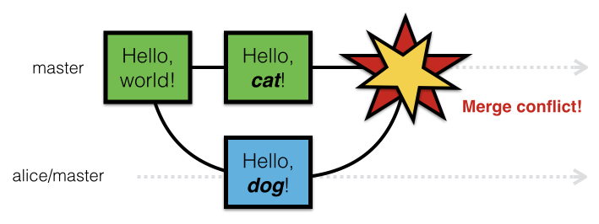
How to handle conflict?

Slide 46
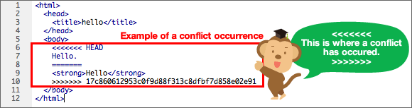
which portion of code is pulled from remote and which is from local?-You can think of the HEAD as the "current branch". When you switch branches with git checkout, the HEAD revision changes to point to the tip of the new branch.

Slide 47
Best practice for your work and interview:
Right click on the project >>>Team>>>Commit....
Move all un-stage files to stage >>>Write up the commit message >> commit and push.
If no one else has pushed any changes, I'm done. If someone has, then the commit succeeds, and the push gets rejected.
Right click on the project and choose Team: Pull. If there are no conflicts, then choose Team: Push to Upstream and I'm done.
If there are conflicts, look through the package explorer to see which files are conflicted. Right click on each conflicted file, and choose Team: Merge Tool. It will show all the changes in both versions of the file, with any conflicts shown in red. Click on the button to merge all non-conflict changes, then edit any red sections manually.
Save the changes to the file. If you want, you can compare it to HEAD to see what changes you are making on top of the changes you just pulled.
Right click on the file and choose Team:>>Add to Index to tell EGit that you've finished merging that file.
Repeat for any other conflicted files.
When all the files are merged, right click on the project and choose Team: Rebase: Continue Rebase. If there are more conflicted commits, go back to dealing with conflicts.
When the rebase is complete, run your tests to see that the rebase didn't break anything.
Right click on the project and choose Team: Push to Upstream.

Slide 48
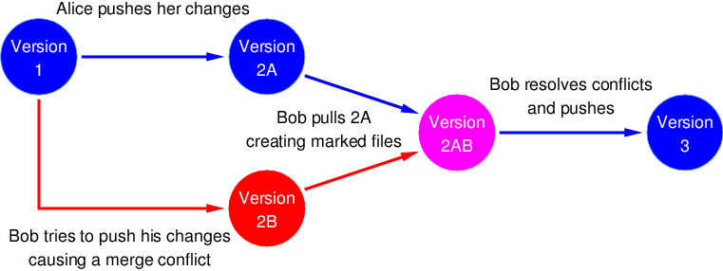
Resolve conflict

Slide 49
The union of branches is done in two ways:
git merge -The best known form is git merge, which performs a fusion to three bands between the last two snapshots of each branch and the common ancestor to both, creating a new commit with mixed changes.
git rebase - basically what it does is to collect one by one the changes confirmed in one branch, and reapply them on another.
Using rebase can help us avoid conflicts whenever it is applied to commits that are local and have not been uploaded to any remote repository. If you are not careful with the latter and a partner uses affected changes, sure you will have problems since these types of conflicts are usually difficult to repair.

Slide 50
git stash- prevent conflict also Using rebase can help us avoid conflicts
Why stash? – to prevent conflict and save your working copy
When stash ? – if multiple people work on same file and possible chance of conflict
How to do stash?-
project> rt click>> team>> stash>> put name>> save a work copy of your code
Now do project> rt click>> team>> pull>> rebase>> get a copy of code from GitHub repo
project> rt click>> team>> stash>>select your name>> git stage>> add your code or delete your code>> commit and push

Slide 51
THANKS

